Slide 1

Pharmaceutical Sales prediction across multiple stores
Raushan kumar

Slide 2
Points for Discussion
Introduction
Problem statement
Data Summary
Approach
Sales with respect to years
Impact of promo on sales
Sales with respect to assortment
Sales with respect to school holiday
Sales on different days of week
Sales with respect to store type
Sales outliers detection and removal
Checking correlation
Linear Regression Model
Decision Tree Regression
Random Forest Regression
Important Features
Conclusion

Slide 3
Introduction:
An important part of present-day business intelligence is sales prediction. Sales prediction can
be termed a complex problem, and it gets harder in the case of lack of data or missing data
values, and the presence of outliers.
This dataset is a live dataset of Roseman Stores. On analysing this problem we observe that Roseman problem is a regression problem and our primarily goal is to predict the sales figures of Roseman problem. Sales forecasting plays an integral role in setting expectations and making plans for your business. It’s your best shot at predicting the future.

Slide 4
Problem Statement
Rossmann operates over 3,000 drug stores in 7 European countries. Currently, Rossmann store managers are tasked with predicting their daily sales for up to six weeks in advance. Store sales are influenced by many factors, including promotions, competition, school and state holidays, seasonality, and locality.
With thousands of individual managers predicting sales based on their unique circumstances, the accuracy of results can be quite varied.
We are provided with historical sales data for 1,115 Rossmann stores. The task is to forecast the "Sales" column.

Slide 5
Data Summary
Id - an Id that represents a (Store, Date) duple within the test set
Store - a unique Id for each store
Sales - the turnover for any given day (this is what you are predicting)
Customers - the number of customers on a given day
Open - an indicator for whether the store was open: 0 = closed, 1 = open
StateHoliday - indicates a state holiday. Normally all stores, with few exceptions, are closed on state holidays. Note that all schools are closed on public holidays and weekends. a = public holiday, b = Easter holiday, c = Christmas, 0 = None
SchoolHoliday - indicates if the (Store, Date) was affected by the closure of public schools

Slide 6
StoreType - differentiates between 4 different store models: a, b, c, d
Assortment - describes an assortment level: a = basic, b = extra, c = extended
CompetitionDistance - distance in meters to the nearest competitor store
CompetitionOpenSince[Month/Year] - gives the approximate year and month of the time the nearest competitor was opened
Promo - indicates whether a store is running a promo on that day
Promo2 - Promo2 is a continuing and consecutive promotion for some stores: 0 = store is not participating, 1 = store is participating
Promo2Since[Year/Week] - describes the year and calendar week when the store started participating in Promo2
PromoInterval - describes the consecutive intervals Promo2 is started, naming the months the promotion is started anew. E.g. "Feb,May,Aug,Nov" means each round starts in February, May, August, November of any given year for that store

Slide 7
Approach
Importing the required libraries and reading the dataset.
Merging of the two datasets
Understanding the dataset
Exploratory Data Analysis (EDA) –
Data Visualization
Feature Engineering
Dropping of unwanted columns and values (closed stores)
Filling Missing Values with Imputation
Outliers Detection and removal
Label Encoding (Converting categorical variables to numerical values)

Slide 8
Model Building
Linear Regression Model
Decision Tree Regression Model
Random Forest Regression Model
Model Validation
r2 score
Mean absolute error
Root mean squared error
Creating the final right model and making predictions
Conclusion

Slide 9
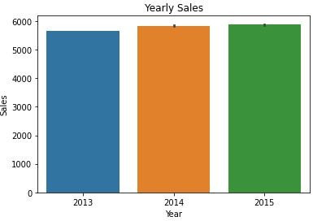
Relation between different Variable
A. Sales with respect to year
Observation- Increasing in sales year to year

Slide 10
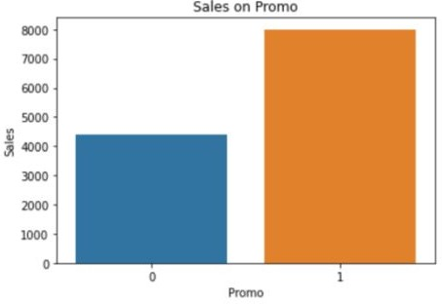
Observation - When promo are running we can expect more sales.
B. Impact of promos on sales

Slide 11
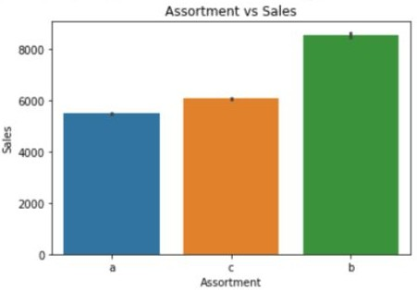
C. Sales with respect to Assortment
Observation - Assortment level 'b' have the highest sales

Slide 12
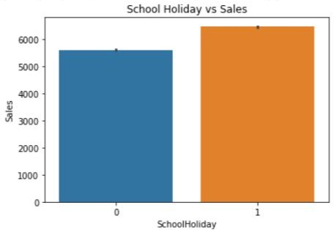
D. Sales with respect to School Holiday
Observation - More sales on School Holidays

Slide 13
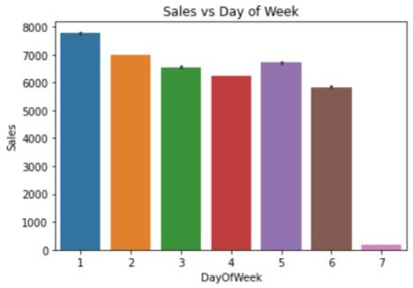
E. Sales on different days of the week
Observation - Monday, Tuesday and Friday have the highest sales and lowest sale on Sunday

Slide 14
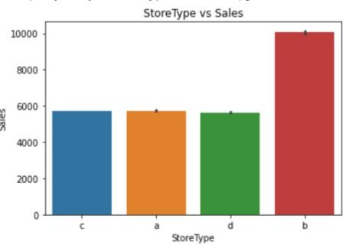
F. Sales with respect to store type
Observation - b type stores have the highest sales.

Slide 15
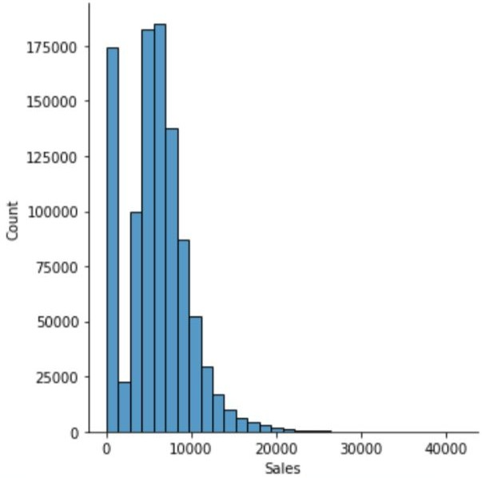
Sales Outliers Detection and Removal
.
Observation - From the above graph we can see
that sales >25k are very less, so it might be an outlier so we drop them.

Slide 16
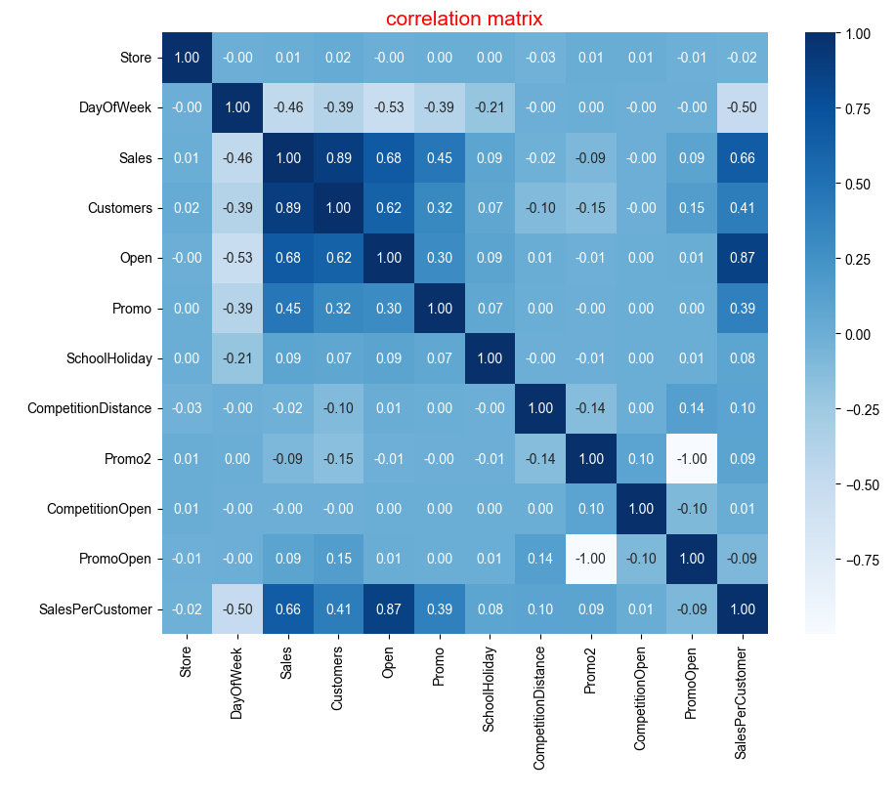
Checking Correlation
Observation- Sales are highly correlated with Customers, Open and Promo code, and minorly correlated to school holidays

Slide 17
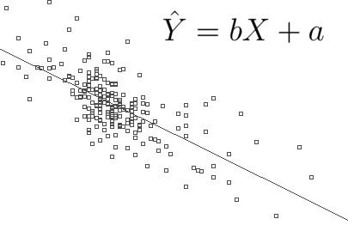
Model Building
A. Linear Regression Model
Linear regression analysis is used to predict the value of a variable based on the value of another variable. The variable you want to predict is called the dependent variable. The variable you are using to predict the other variable's value is called the independent variable.

Slide 18
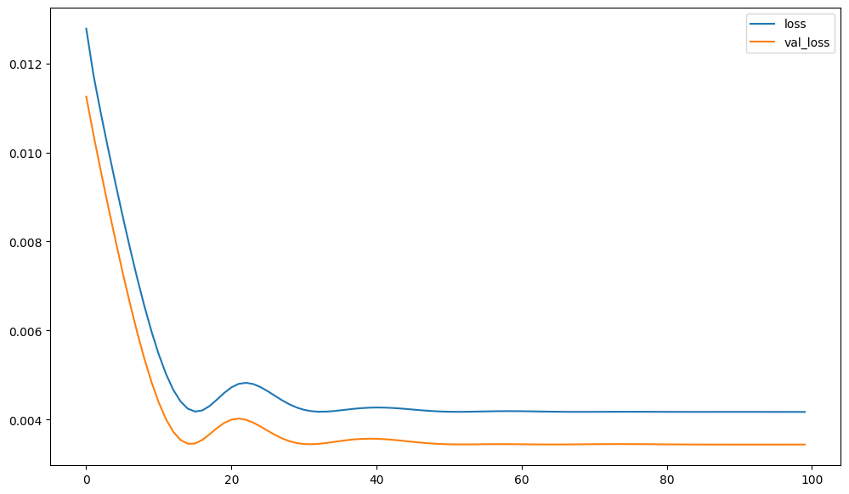
Performance of Model
The r2_score of Linear Regression is: 0.7784061010317642
The Mean absolute error of Linear Regression is: 992.30
The Root mean squared error of Linear Regression is: 1914.395102807405
Observation - From the above plot we can see that Linear regression model is performing badly as its not making any predictions more than 10000.

Slide 19
B. Decision Tree Regression
Decision Tree Regression:
Decision tree regression observes features of an object and trains a model in the structure of a tree to predict data in the future to produce meaningful continuous output. Continuous output means that the output/result is not discrete, i.e., it is not represented just by a discrete, known set of numbers or values.
Discrete output example: A weather prediction model that predicts whether or not there’ll be rain on a particular day.
Continuous output example: A profit prediction model that states the probable profit that can be generated from the sale of a product.

Slide 20
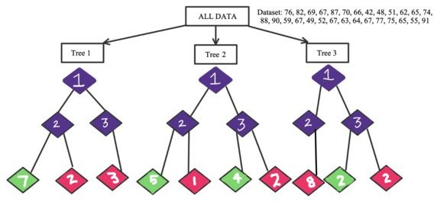
Performance of Model
The r2_score = 0.9519176919198888
The Mean absolute error = 420.01
The Root mean squared error =
891.7545389502772
Observation - The decision tree regressor performing well as compared to linear regressors

Slide 21
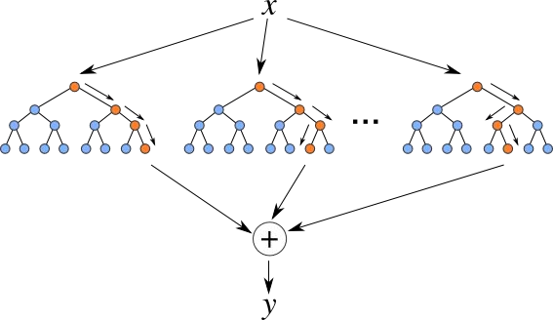
C. Random Forest Regressor
Random Forest Regression is a supervised learning algorithm that uses ensemble learning method for regression. Ensemble learning method is a technique that combines predictions from multiple machine learning algorithms to make a more accurate prediction than a single model.
Step 1: Identify your dependent (y) and independent variables (X) Step 2: Split the dataset into the Training set and Test set
Step 3: Training the Random Forest Regression model on the whole dataset
Step 4: Predicting the Test set results

Slide 22
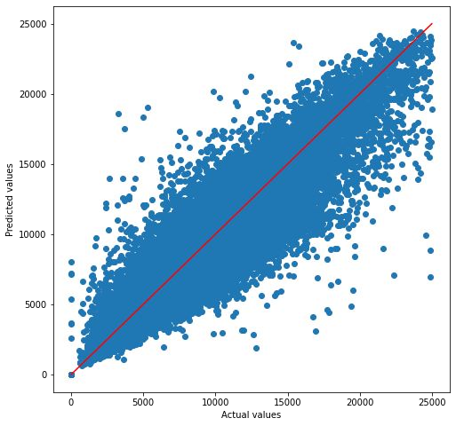
Performance of Model
The r2_score: 0.9156108742155831
Mean absolute error: 355.77
Root mean squared error:
754.1595639323232
Observation - Random Forest regressor have the highest r2 score and lowest error as compared to other models

Slide 23
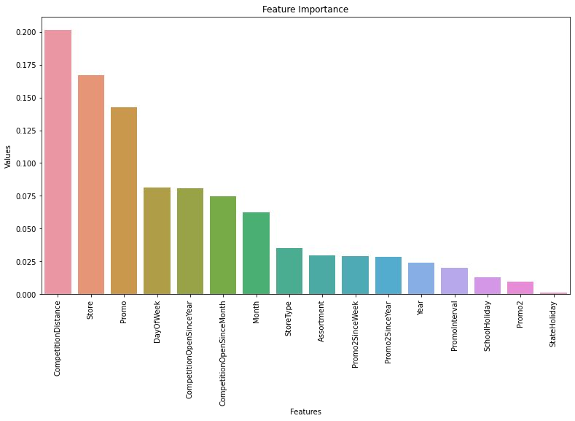
Important Features
Top 5 important Features are:
CompetitionDistance
Store
Promo
DayOfWeek
CompetitionOpenSinceYear

Slide 24
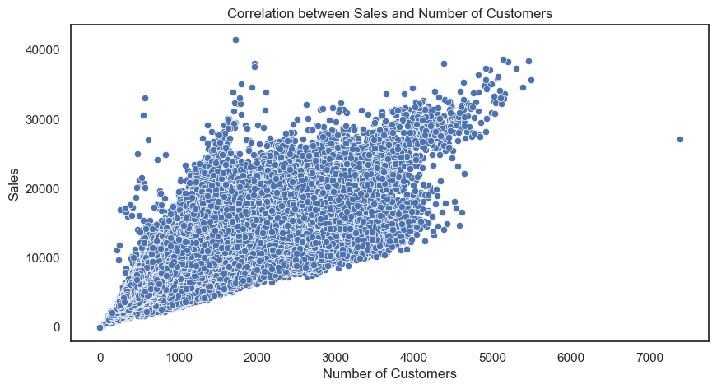
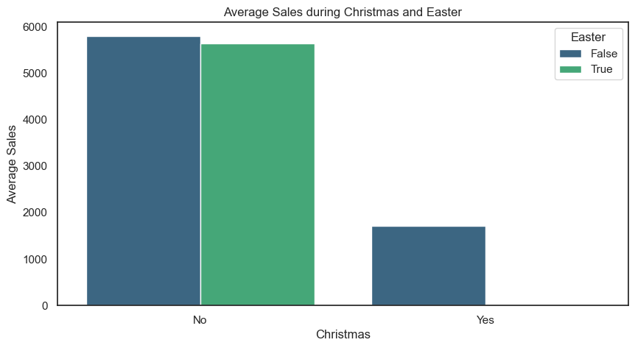
correlation between sales and number of
customers?
Average Sales during Christmas and Easter'

Slide 25
Conclusion
As competition is very high, promo codes can help them to boost their sales. We have observed that sales also depend upon the store type. Store model B has the highest number of sales out of all store models like A, B, C, and D. Sales was also depending upon the days of the week, as Monday and Friday received the highest number of sales. Also, the assortment has a role in sales and assortment level b has the highest sales.
We have seen a huge difference in sales when the Promo code was available in the store. Also, most of the stores are closed on Holidays, so state holidays do not affect sales

Slide 26
Thank you

